Slide 1


IGNITE
Pitch Deck
Milestone 4

Slide 2
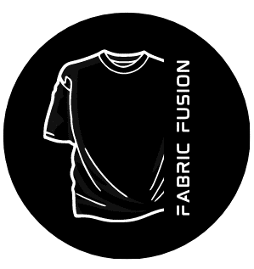


Who we are
Fabric Fusion
Why ?
In today's market more time is being consumed for designing an unique and attractive output
The representation of Tamil fashion through dialogues are less compared to the popularity seen in comics and anime trends.
What ?
At Fabric Fusion, we redefine the art of personalized fashion by seamlessly blending cutting-edge technology with your unique sense of style. Our revolutionary approach combines the craftsmanship of fabric design with the power of Artificial Intelligence, giving you the ultimate platform to express yourself like never before.
How ?
Designing With help AI, ensuring a quicker and efficient process for personalized designs To capture the customer who want actual unique designed T shirts

Slide 3
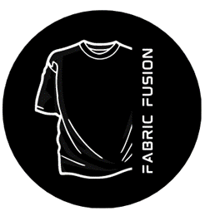
Problem/Opportunity
CONTEXT When individuals perceive that designs in the market are repetitive those seeking to imprint their thoughts on T-shirts often aim for originality. | PROBLEM The design process can be quite time-consuming. Tamil fashion is less represented through dialogues compared to the widespread popularity observed in comics and anime trends. | ALTERNATIVES Some individuals invest more effort and time into customized designs. Certain individuals find themselves with plain T-shirts in the end.
CUSTOMERS Students Youngsters In the age group of 14 to 35 | EMOTIONAL IMPACT Their confidence in their outfit is diminished. Their satisfaction is diminished. | ALTERNATIVE SHORTCOMINGS Time consuming Spending more amount on simple design Sometimes mismatch in colors/details
 | QUANTIFIABLE IMPACT This issue affects approximately 60% of people.

Slide 4
Problem Interviews And Surveys Results
How many customers did you interview? 10
What was the interview mode?
Offline
How many of them agree this is a problem and wants a solution?
7
How many of them said they don't need a new solution?
3

Slide 5
Market Size Estimation
US$5.10bn
US$5,920m
US$10,000
How to calculate market size?
1. Start with Total Addressable market-
TAM refers to the total market demand for a product or service.
If you’re entering a pre-existing space (like small business banking) you can research it and provide credible sources or reference points on how you arrived at the TAM. If you’re creating a new product or space (like Slack), you can estimate the number of customers that would want your product and approximate how much you could charge them.
2. Take your target market (SAM), within that TAM, which varies depending on geography and other logistical factors. Determine the penetration potential of your target market. This is the portion of the market you can reasonably compete with……………………………..
3.By conducting research with existing competitors, distributors etc., understand the likely penetration rate………………….
4. Multiply target market by penetration rate to find your market size…………………….
.
https://www.statista.com/outlook/cmo/apparel/men-s-apparel/t-shirts/india

Slide 6
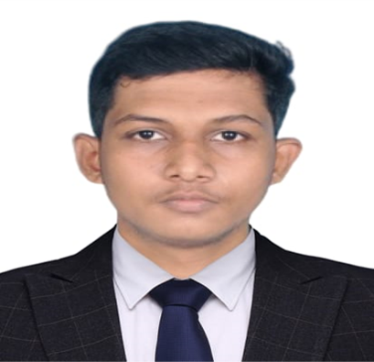
Customer Persona
Open-minded
Ambivert
Optimistic
Goals
Attain employment with a top-tier MNC and experience continuous professional growth.
Strive to express individuality and confidence through curated clothing choices.
Motivations
Ethos
Top student, socially responsible, excels academically, and drives positive change through community service.
Frustrations
Frustration arises from outdated designs
leading to exhaustion in the search for suitable options.
Personality
Bio
Hailing from the culturally vibrant town of Kumbakonam, he is currently dedicated to pursuing a B.Tech in Computer Science and Engineering while actively refining his programming abilities. Residing in a hostel to facilitate his academic journey, he remains deeply immersed in his educational pursuits.
Age: 20
Occupation: Student
Location: Chennai
Notes:
Time: 7 mins
Get students to brainstorm on the customer persona and VPC

Slide 7
Value Proposition Canvas
.
I would LOVE it if:
? What would make the customer happy?
? What do the clients want when facing the problem?
They need design for their sense of style
The Price would be affordable
Quick designing
What do you offer that makes the customers happy?
Unique Design
Affordable Price
Time saving
What is the product or service that you are offering?
Printed T-shirts
Customized Design T-shirts
I would WANT:
What do the clients do (actions) when facing the problem?
They get unsatisfaction on designed T-shirts and go for plain T-shirts
GAIN CREATORS
FIT
GAINS
PRODUCT/
SERVICE
JOBS
PAIN KILLERS
PAINS
Which features of your offering relieve the customer's pains?
Uniqueness
Design According to their sense of style
I would HATE it if:
What are the pains of the clients when facing the problem?
Not attractive design
High Prices
More Time consuming to design

Slide 8
Solution
Benefits:
1.Unique Designs: Customers receive one-of-a-kind designs tailored to their preferences, ensuring their T-shirts stand out from the crowd and reflect their individual style and personality.
2. Time Saving: Our efficient processes and user-friendly platform save customers time by providing quick and convenient access to a wide range of customizable designs, eliminating the need for extensive searching or design work.
3. Creating Different Trends: By offering a diverse selection of designs and customization options, we empower customers to experiment with various styles and create their own fashion trends, fostering creativity and self-expression. This enables them to stay ahead of the curve and set new trends in the fashion industry.
We offer
Liberate fashion choices with Fabric Fusion's user-friendly platform, enabling effortless mix-and-match customization for a truly unique and personalized look
Designing unique and appealing outputs takes too long in today's market. Fabric Fusion solves this with AI integration, ensuring a quicker and efficient process for personalized designs.
Boost Tamil fashion representation in dialogues by creating captivating designs and promoting them widely to increase awareness and appreciation, addressing the current disparity compared to comics and anime trends
Notes:
Evaluation Criteria for slides 8 and 9
Check the following on the correctness of VPC: a. Have you identified the correct pains & gains; pain relievers & gain creators (2 marks) b. Have you identified the correct Jobs-to-be-done? (1 mark) c. Are the pain relievers addressing the customer pains? (1 mark) d. Have you identified the right value proposition so that the solution makes the customer's life better? (1 mark)

Slide 9
Competition Analysis
Competitors | Bewakoof | Inkmonk | Zudio | Max | Fabric Fusion
Product | Customizable Printed T -shirt | Customizable Design T-shirt | Clothing | clothing | Customizable Printed T-shirt & Printed T-shirt
Benefits | Custom Design | Custom Design | Affordable Price | Various Offers | Custom Design
Branding channels | Paid Promotion &Social media | Social Media &Paid Promotion | Influencer Branding | TV ads, social media | Social Media & word of mouth
Mode of Business | Online | Online | Online & Offline | Online & Offline | Online & Offline
Limitations | Expensive | Only Bulk Orders | Repetitive Design | Overpriced | T-shirt Only
UVP | Design With Customer Perspective | Handle Bulk Orders for Events | Economical | Availability | Low time Consumption

Slide 10
Lean Canvas
PROBLEM
Customers want customized T-shirts that reflect their unique style and preferences.
Limited & Repetitive Design
The design process can be quite time-consuming.
EXISTING ALTERNATIVES
Some individuals invest more effort and time into customized designs.
Certain individuals find themselves with plain T-shirts in the end.
SOLUTION
Fabric Fusion offers a user-friendly platform for mix-and-match customization
We uses AI to speed up design processes, meeting the demand for personalized fashion.
UNIQUE VALUE PROPOSITION
customizable T-shirt designs created with AI for a unique and personalized experience.
Economical
HIGH-LEVEL CONCEPT
Fabric Fusion builds a vibrant online community where fashion enthusiasts can share and discover personalized designs
fostering creativity and connection across borders.
UNFAIR ADVANTAGE
Fabric Fusion's AI platform enables rapid design iteration
leveraging customer feedback and market trends for enhanced speed and agility.
CUSTOMER SEGMENTS
Fashion-conscious individuals
Event Organizer
Boutique owners
Fashion influencers
EARLY ADOPTERS
Fashion-forward individuals who seek unique and personalized clothing options.
Event planners looking for customized apparel for special occasions.
Fashion influencers and trendsetters eager to showcase personalized styles to their followers.
KEY METRICS
Customer lifetime value
Conversion rate
Customer satisfaction score.
CHANNELS
Online Store
Social Media
Instagram
Word of mouth
COST STRUCTURE
Variable Costs: Costs tied directly to the production and sale of custom T-shirts, including materials and inventory management.
Fixed Costs: Costs that remain consistent irrespective of the number of custom T-shirts sold, covering expenses like Platform & hosting charges.
REVENUE STREAMS
Direct Sales
Customization Fees
Bulk Orders
Subscription Model.

Slide 11
MVP
PRODUCT DESCRIPTION
Fabric Fusion is an innovative online platform that revolutionizes the way people interact with fashion by offering customizable T-shirts designed with the help of AI technology. Our platform empowers customers to express their individuality and style through personalized designs that reflect their unique preferences and personality.
KEY FEATURES:
AI-Powered Design Assistance: Fabric Fusion's AI algorithms analyze customer input and preferences to generate personalized T-shirt designs tailored to each individual's style and preferences.
Professional Designers: Our team of skilled designers works in tandem with the AI tool to create high-quality and visually appealing T-shirt designs that meet customer specifications.
Seamless Ordering Process: Customers can easily provide their input and preferences through our user-friendly platform, and the AI tool and designers take care of the rest, ensuring a hassle-free ordering process.
High-Quality Products: Fabric Fusion utilizes top-quality materials and printing techniques to produce custom-designed T-shirts that meet the highest standards of quality and durability.
How It Works:
Customers provide input and preferences regarding their desired T-shirt design through Fabric Fusion's platform.
Our team analyzes the customer's input and generates personalized design with help of Ai tools based on their preferences.
We review the AI-generated designs and make any necessary adjustments or enhancements to ensure the final design meets the customer's expectations.
Once the design is finalized, then T-shirt is Printed and ready to ship.
Fabric Fusion's production team utilizes high-quality materials and printing techniques to create the custom-designed T-shirt according to the finalized design.
The finished T-shirt is then shipped directly to the customer's doorstep, ready to be worn and enjoyed.

Slide 12
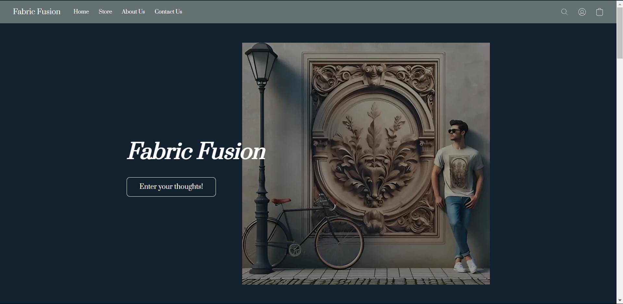
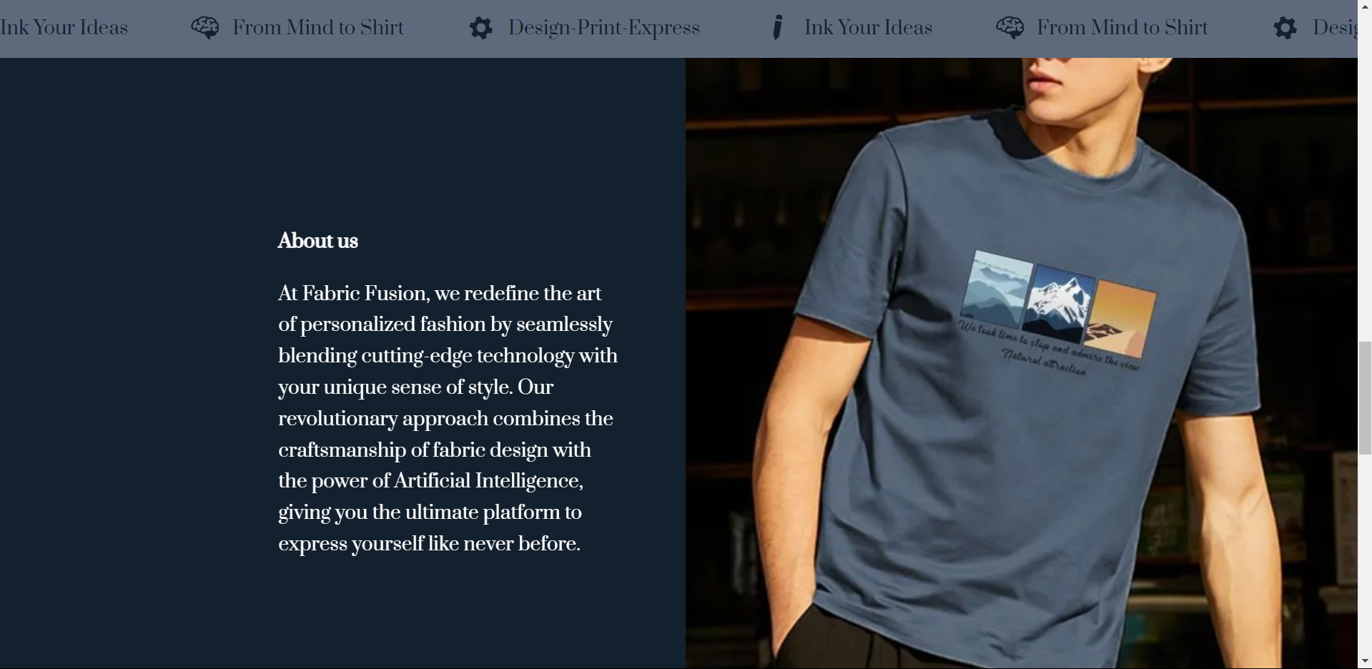
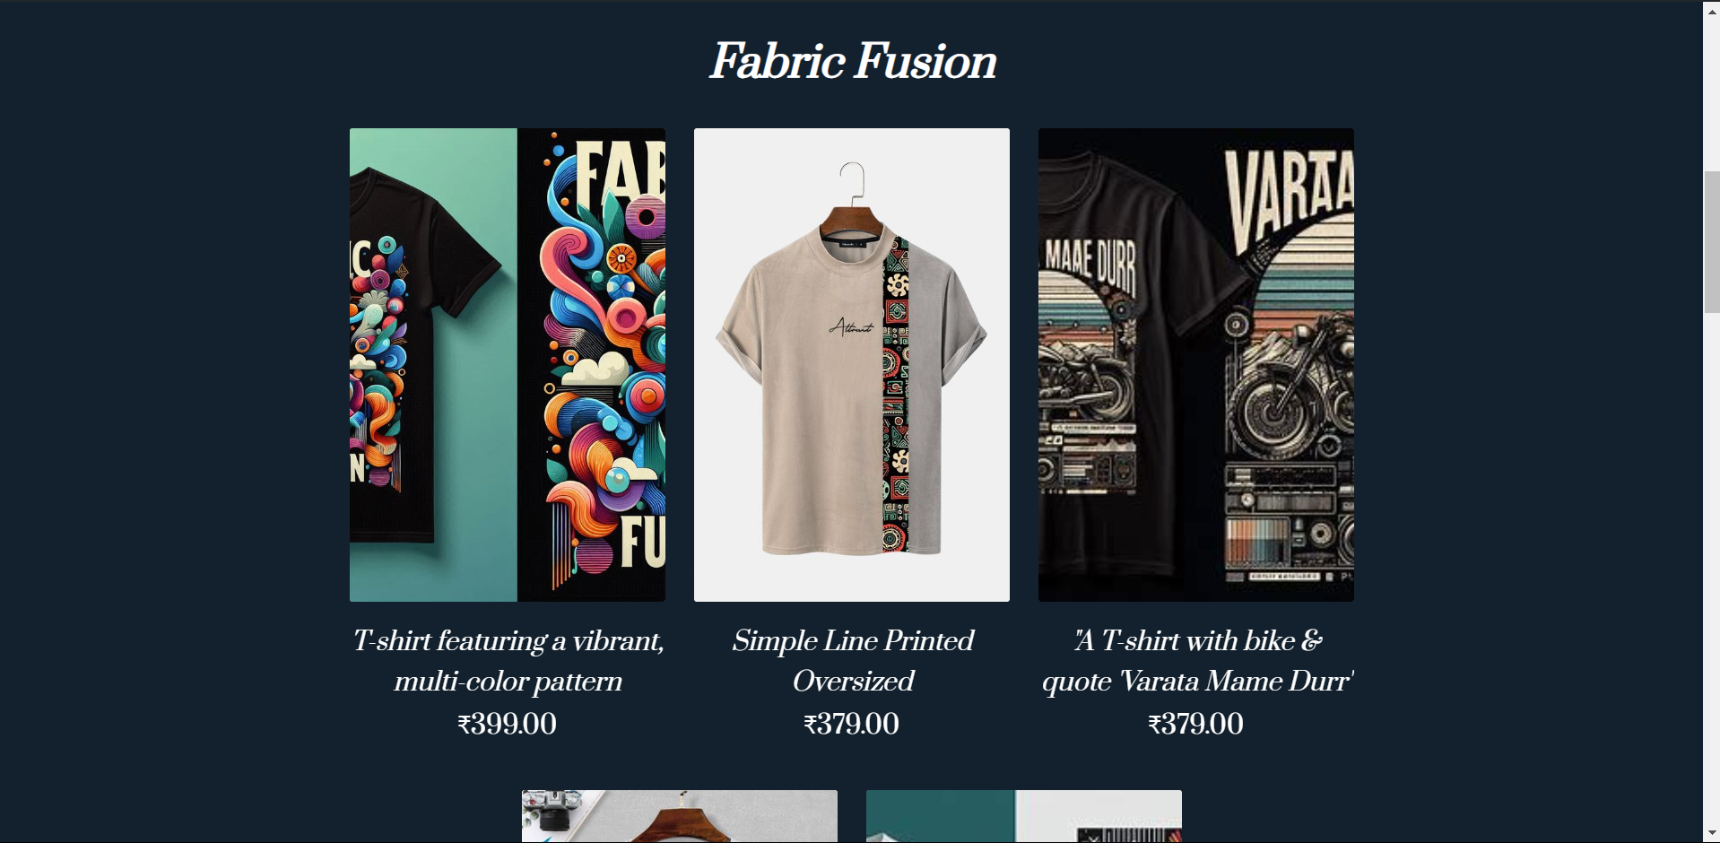
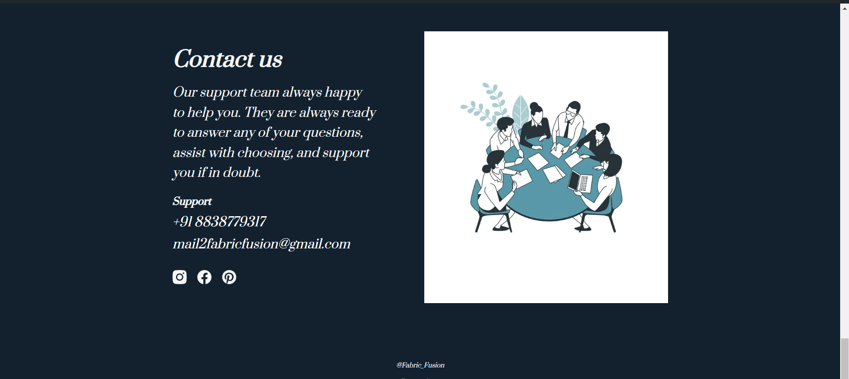
Venture Website
Website Link:
https://fabric-fusion.company.site/

Slide 13
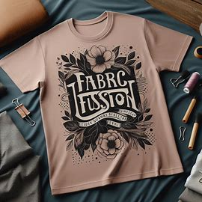
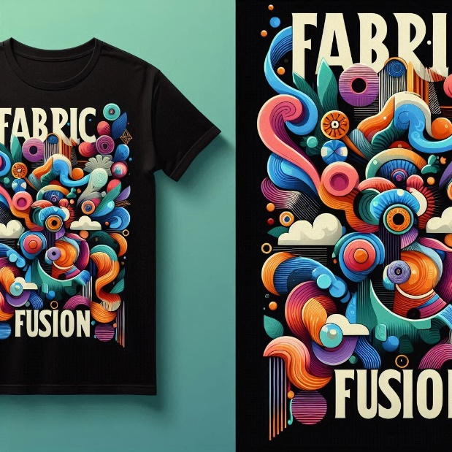
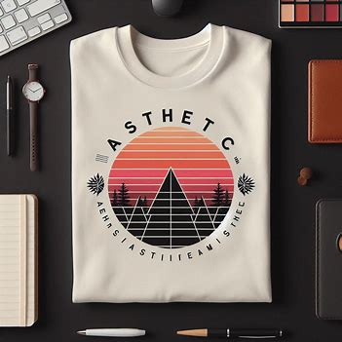
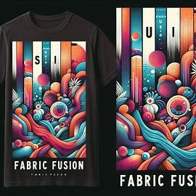
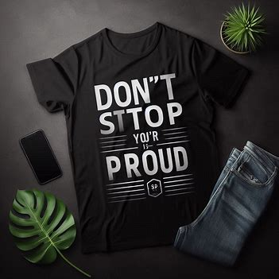
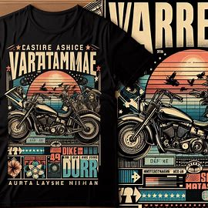
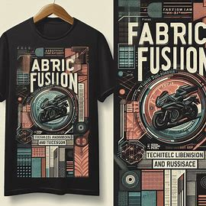

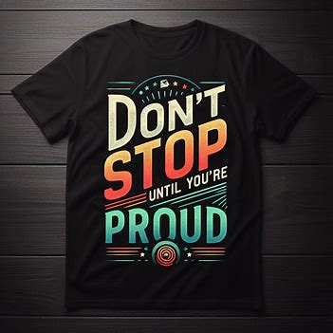
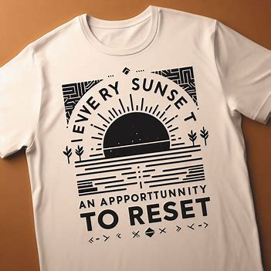
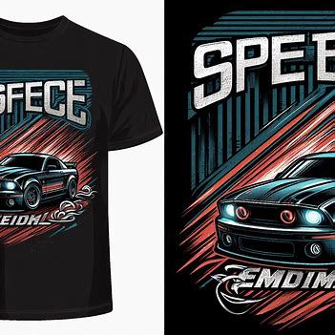
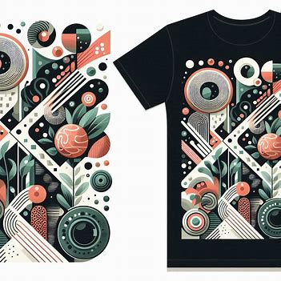
Ai generated Sample Designs

Slide 14
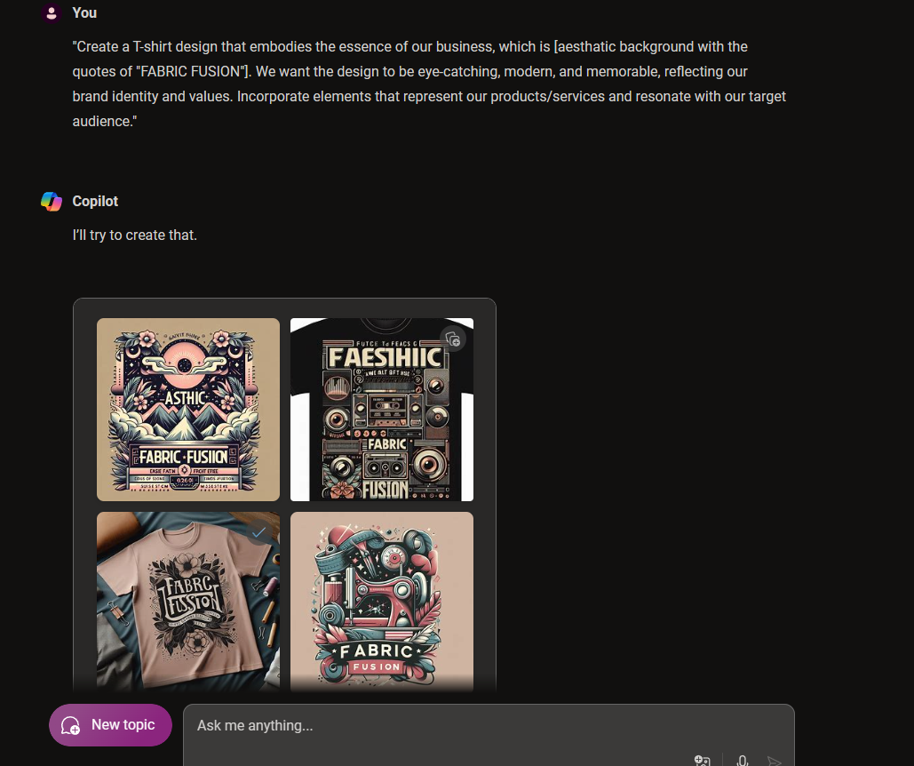
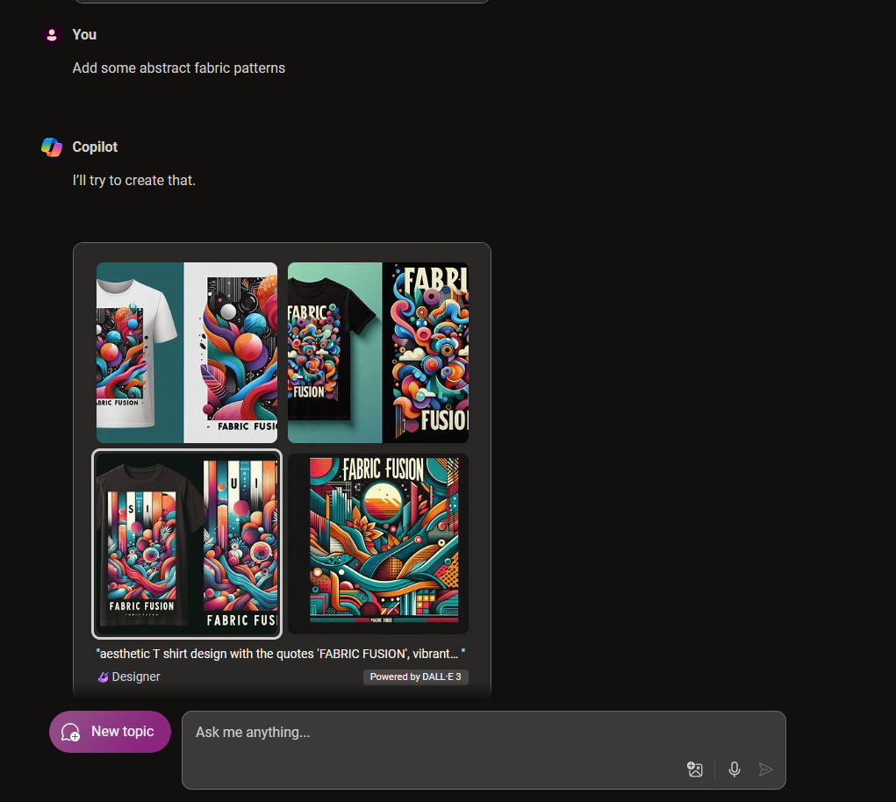
Ai tool(copilot)
At present, our team predominantly utilizes open-source AI solutions. However, we are contemplating integrating paid AI services supported by APIs into our website framework in the future. This strategic consideration would allow us to broaden our technological capabilities modestly, potentially enhancing user experiences through additional functionalities and personalized interactions. By cautiously embracing these advanced AI tools, we aim to stay abreast of technological advancements while catering to our customers' evolving requirements.

Slide 15
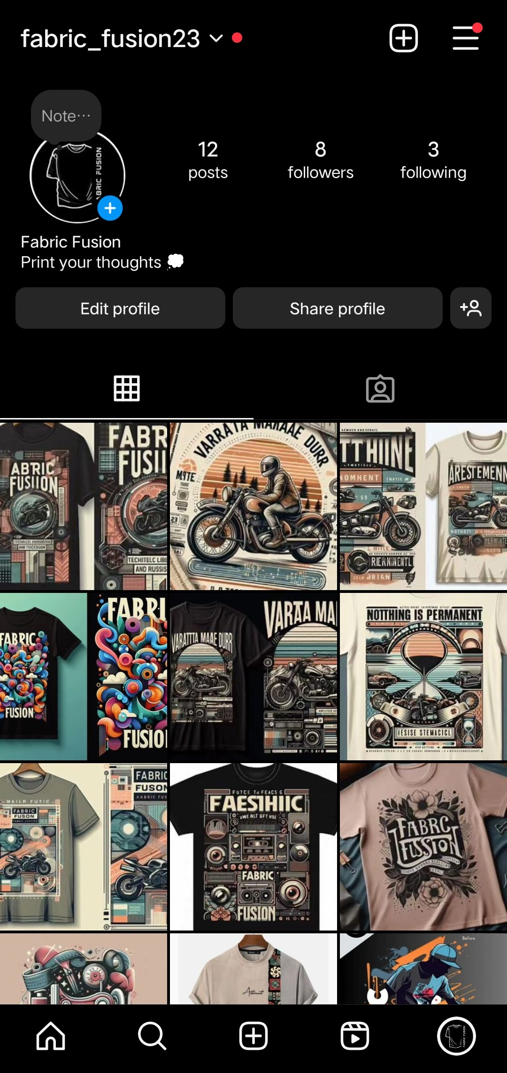
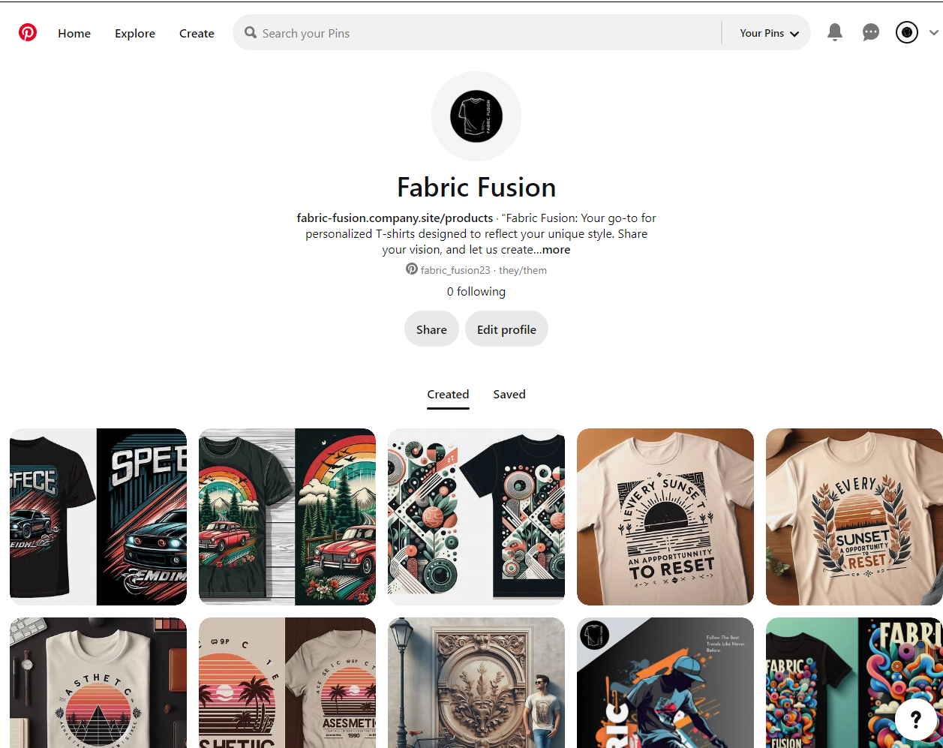
Social Media

Slide 16

MVP Validation
What is your MVP
Fabric Fusion's MVP is a platform for generating personalized T-shirt designs based on user inputs.
Conclusion:
Test Details:
Persevere
How long will we test this MVP?
3 to 5 months
Pivot
Who is our target audience for the test? How many of them?
College students and Fashion Influencer, 50-100 persons
Not conclusive
How will we get to that audience?
Through college and social media
Results of Test:
Realizations / Insights:
Robust demand for personalized T-shirt designs and positive feedback on our user-friendly platform suggest promising growth. Strengthening marketing and incentivizing customer referrals can enhance our reach. Ongoing refinement and prioritizing customer satisfaction are essential for sustained success.
Did enough customers buy? Why or why not?
Customers bought enough due to effective marketing strategies and strong product-market fit.
Did customers pay the price we expected? Why or why not?
Customers paid the expected price due to perceived value and competitive pricing strategy.
Did customers come back to our product or show interest in doing so? Why or why not?
Customers showed interest in returning due to positive user experience and satisfaction with the personalized designs.
Next Steps:
Strengthen marketing for wider reach.
Introduce referral programs for customer evangelism.
Gather feedback for platform refinement.
Prioritize customer support and engagement.
Include Ai Api to our website
Did customers recommend our product to others or evangelize about it? Why or why not?
Customers evangelized about our product due to its unique customization options and high-quality designs.
Notes:
Evaluation Criteria for slides 12 to 14
Check the following on MVP? 1. Does it look credible and showcasable? Add a picture/video of the MVP? (3 marks) 2. Have you validated the product benefits and the price with real customers? Add the MVP interview records in a Google drive and add to the PPT. (1 + 1 marks)

Slide 17
Sales Plan
Customer Sales Funnel
Customer Acquisition Plan
TARGET MARKET:
15-30 age
OPPORTUNITIES/PROSPECTS:
Over 55% of the citizens in cities
CUSTOMER:
3000
LEADS:
Over 7000+ through social media
1 | 2 | 3 | 4 | 5
Target Customer Segment (Type) | Target Customer Segment (Number) | Channels to be used to attract the target customer segment | Estimated number of leads | Estimated cost to convert these leads to actual customers
Students | 50K+ | Events & Social Media | 7k+ | 25k
Fashion Influencer | 10K+ | Social Media | 2k+ | 6K
Event Organizer | 10k+ | Events & Social Media | 3K+ | 4K
Notes:
Evaluation Criteria for slide 20 to 22
1. Does the venture have a Sales projections sheet with monthly sales targets and customer funnel defined for the next one year? (2 marks) 2. Does the venture have an active social media presence, such as FB, Instagram, LinkedIn? (1 mark) 3. Do you have a well-thought out brand name, logo, and a Positioning statement? (1 mark) 4. Have you made an actual sale? (1 mark)

Slide 18
Go-to-Market Strategy
Social Media Presence:
Facebook: Regular posts featuring customer testimonials, product highlights, and interactive polls.
Instagram: Daily posts showcasing T-shirt designs, user-generated content, and stories featuring design processes and customer feedback.
Twitter: Quick updates, engagement with trending topics, and customer service responses.
Pinterest: Curated boards with T-shirt design inspirations and style guides.
Positioning Statement:
Statement: "Fabric Fusion: Personalized T-shirt designs crafted uniquely for you, combining your vision with our design expertise to create high-quality, custom apparel that stands out."
Action Plan to Reach Sales/Customer Target for the Next Year:
Q1:
Launch targeted social media and Google Ads campaigns.
Host a virtual launch event with influencer partnerships.
Offer a limited-time discount for first-time customers.
Q2:
Implement a referral program with discounts for referrals and referees.
Expand content marketing with blog posts and videos on fashion trends and customization tips.
Attend virtual fashion trade shows to increase brand visibility.

Slide 19
Go-to-Market Strategy
Q3:
Introduce a subscription service for exclusive designs and discounts.
Begin targeted email marketing campaigns to nurture leads and encourage repeat purchases.
Partner with corporate clients and event planners for bulk orders.
Q4:
Launch new customization options based on customer feedback.
Increase advertising spend for holiday promotions.
Host a customer appreciation event with special offers and giveaways.
Sales & Distribution Model:
Sales Channels:
Website: Primary platform for ordering and customizing T-shirts.
Social Media Shops: Utilize Facebook and Instagram shops for direct sales.
Marketplaces: List products on Etsy and Amazon for broader reach.
Distribution Channels:
Direct Shipping: Partner with reliable courier services for direct-to-consumer deliveries.
Fulfillment Centers: Use regional fulfillment centers to optimize shipping times and costs.
Bulk Distribution: Provide bulk shipping options for corporate clients and event planners.

Slide 20
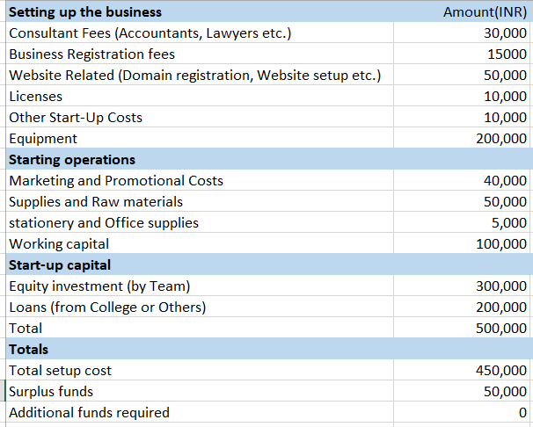
FINANCIAL PLAN
Start-up Costs
Explanation:
The cost of the Fabric Fusion is similar to traditional design printing shop. There's an initial investment for setting up (website, machineries).. Then there are ongoing costs (rent, supplies)
Notes:
Evaluation Criteria for slide 24
1. Have you done their Unit Economics and come up with CAC, CLV, ARPU, Net and Gross Profit? (1 mark) 2. Do you have a plan on how to reduce their CAC and churn rate, and increase their CLV, ARPU, and Net Profit Margin? (2 marks) 3. Is the capital asked for as per the Funding plan in line with the business? (1 mark) 4. How long will it take you to return the investment? (1 mark)

Slide 21
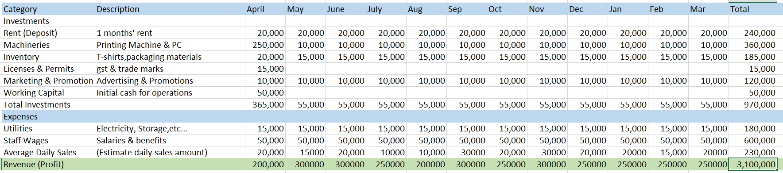
Forecast P&L
Explanation: It details one-time investments in the first month (Machineries, Inventory) and other ongoing expenses (rent, utilities) over eleven months.
link: https://drive.google.com/drive/folders/1_j3z90IcKjYHptgEoDLx-gi1dm4k6P9C
Notes:
Evaluation Criteria for slide 24
1. Have you done their Unit Economics and come up with CAC, CLV, ARPU, Net and Gross Profit? (1 mark) 2. Do you have a plan on how to reduce their CAC and churn rate, and increase their CLV, ARPU, and Net Profit Margin? (2 marks) 3. Is the capital asked for as per the Funding plan in line with the business? (1 mark) 4. How long will it take you to return the investment? (1 mark)

Slide 22
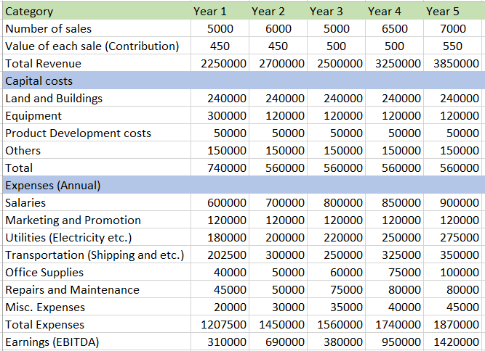
Financial Projections
Notes:
Evaluation Criteria for slide 24
1. Have you done their Unit Economics and come up with CAC, CLV, ARPU, Net and Gross Profit? (1 mark) 2. Do you have a plan on how to reduce their CAC and churn rate, and increase their CLV, ARPU, and Net Profit Margin? (2 marks) 3. Is the capital asked for as per the Funding plan in line with the business? (1 mark) 4. How long will it take you to return the investment? (1 mark)

Slide 23
Unit Economics
Assumptions (Year 2024)
P & L/ unit | Year 1
Revenue | 450
COGS | 200
Gross Profit | 250
Gross Profit Margin | 55%
Operating Costs | 50
Operating Profit | 100
Unit Economics | Year 1
CAC(Customer acquisition Cost) | 200
CLV(Customer Lifetime Value) | 500
ARPU(average Revenue Per User) | 200

Slide 24
Funding Plan
1. Product Development (30%):
Enhance AI design tools and product quality.
Continuous R&D for new features.
2. Marketing and Sales (40%):
Targeted digital marketing and social media ads.
Collaborations with influencers and engaging content creation.
3. Operations and Logistics (15%):
Partner with fulfillment centers for efficient shipping.
Implement inventory management and customer support.
4. Website and Technology (10%):
Improve website functionality and develop a mobile app.
Invest in IT infrastructure for scalability.
5. Miscellaneous and Contingency (5%):
Cover legal, administrative costs, and reserve for emergencies.
How much funds required to reach to the next level of the venture?
10 lakhs
How much have been bootstrapped? If not, why ?
250000
How much can be bootstrapped?
5 lakhs
How much external funding required? If not, why?
5 lakhs

Slide 25
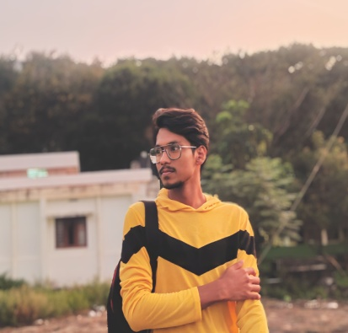
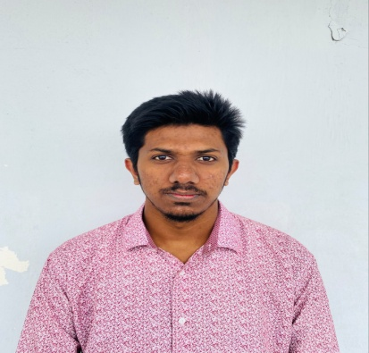
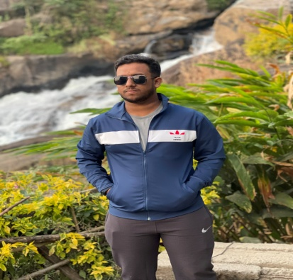
Team Composition
Team member 1
Team member 2
Team member 3
What makes us a good team to solve the problem we chose?
Our team is uniquely positioned to tackle the challenges in the T-shirt venture. With a blend of diverse skills encompassing design, marketing, and logistics, we offer comprehensive problem-solving capabilities. Fueled by a genuine passion for fashion and backed by extensive market research, we possess a deep understanding of customer preferences and emerging trends. Our collaborative approach fosters innovation, allowing us to leverage each member's strengths effectively. Drawing from past successes, we are adaptable and resilient in navigating uncertainties. Above all, our unwavering commitment to customer satisfaction drives us to create T-shirt designs that truly resonate with our target audience.
Role/Position:
CEO
Role/Position:
CTO
Role/Position:
CMO
Key Strengths and abilities
Leadership qualities
Situation handling
Work Optimization
Time management and organization
Key Strengths and abilities
Designing
Creative Thinking
Knowledge in New Technology
Attention to detail
Key Strengths and abilities
Networking
Handling Customers
Teamwork and collaboration
Creativity and innovation

Slide 26
Thank You!

